Slide 1
Mission and Ministry
What the future looks like
Where we’re going and how we’re getting there

Slide 2
Slides #12, 15, and 21 are courtesy of “Reimagining Church,” a course offered by Fresh Expressions Canada ( freshexpressions.ca ).

Slide 3
The church is changing
In 2005, 14,000 people attended Anglican services on Sunday in the Diocese of Huron
In 2015, 9,200 people attended Anglican services on Sunday in the Diocese of Huron
That is a decrease of 30%

Slide 4
Really, it is
In 2005, 3,000 people attended Anglican services on Sunday in London
In 2015, 2,000 people attended Anglican services on Sunday in London
That is a decrease of 33%

Slide 5
But, maybe not enough
In 2005, we had 209 congregations
By the end of 2016, we had 178 congregations, nearly all with their own buildings
That is a decrease of 15%, which is half the rate of attendance decrease

Slide 6
We need fewer buildings
We need lots of congregations
We can’t afford many buildings

Slide 7
The trend won’t change by itself
Demographics: in the pews, doing the work, providing the funds
Too many church buildings
Competing with each other

Slide 8
Needed
Today, we need a general population of 30,000 people to support an Anglican parish with building and full-time clergy.
That’s lower than most places, because people in Huron are loyal church-attendees.
Soon, that won’t be enough.

Slide 9
Death
The death of a model.
But, not the death of the church.

Slide 10
Neighbourhood/Parish Model Dying
In urban areas
In rural areas

Slide 11
Resurrection
Mixed Economy
Ministry Centres

Slide 12
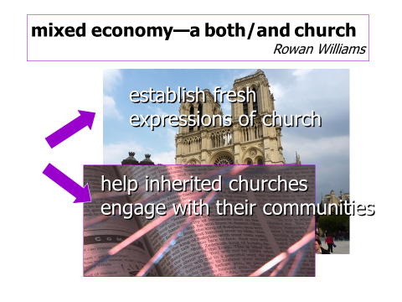
Mixed Economy

Slide 13
The Inherited Church
Mission-focused: built around all 5 of the Marks of Mission
Fewer buildings: specialized and/or serving larger areas
Ministry centres: creating and supporting Fresh Expressions

Slide 14
Fresh Expressions
“A fresh expression is a form of church for our changing culture established primarily for the benefit of people who are not yet members of any church.”

Slide 15

Doing church differently

Slide 16

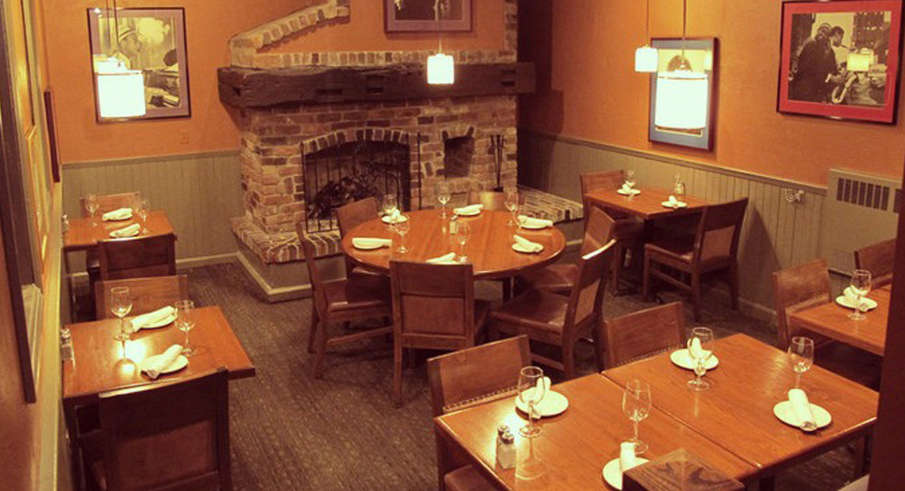
Meet in a home or restaurant

Slide 17
Evangelism and Discipling
All of us, lay and clergy, will be called to speak our faith to others
To do that, we will need to understand our faith more deeply

Slide 18
Formation at the heart
The central activity of the church will be forming people to live and share the Good News of Christ Jesus

Slide 19
Ministry Centres – Ministry Teams
Fewer buildings, with larger teams of clergy and lay leaders
Supporting smaller congregations, largely fresh expressions

Slide 20
A church to reach others
Strategic Plan priority #1: Becoming a church with an outward focus on mission

Slide 21
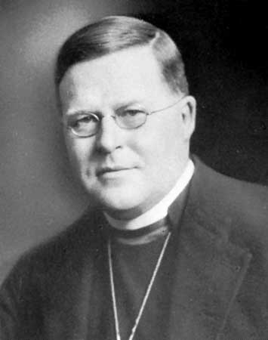
The church is the only society in the world that exists for the benefit of its non-members.
William Temple Archbishop of Canterbury

